Slide 1
STATE-OWNED ENTERPRISE REFORMS

Slide 2
What is the daily cost of keeping the CPC, CEB, SLA, NWSDB and Sathosa afloat?

Slide 3
What is a State-Owned Enterprise?
Incorporated by an Act of Parliament, but a recent trend has been for these entities to be incorporated under the Companies Act.
SOEs in Sri Lanka include statutory bodies, regulatory agencies, promotional institutions, educational institutions, public corporations and limited companies.

Slide 4
How many SOEs are there really?
How many subsidiaries do these SOEs have?

Slide 5
The State of State-Owned Enterprises in Sri Lanka
Cumulative losses of the 55 SOEs from 2006-2020 1.2 trillion
Total Number of SOEs in Sri Lanka 527
SOEs classified as “Strategically Important” by the Treasury
55
Cumulative profits of the 55 SOEs from 2006-2020
1.27 trillion
Percentage of SOEs for which financial information is available
10.4%
Source: Advocata Institute https://www.research.advocata.org/wp-content/uploads/2019/03/THE-STATE-OF-STATE-ENTERPRISES-IN-SRI-LANKA-PS-1.pdf

Slide 6
The Issue with Subsidiaries

Slide 7
Subsidiaries under the Sri Lanka Insurance Corporation
Name of SOE | Ministry | Direct Subsidiaries | Sub Subsidiaries
Sri Lanka Insurance Corporation | Ministry of Finance | The Lanka Hospitals Corporation PLC (51.34%) | Lanka Hospitals Diagnostics (Pvt) Ltd. (100%)
 |  | Litro Gas Lanka Ltd. ( 99.94% )
 |  | Litro Gas Terminal Lanka (Pvt) Ltd.100%
 |  | Canowin Hotels and Spas (Pvt) Ltd.100%
 |  | Canwill Holdings (Pvt) Ltd.45.95% | Sinolanka Hotels & Spa (Pvt) Ltd.100%
 |  |  | Helanco Hotels & Spa (Pvt) Ltd.100%
 |  | Management Services Rakshana (Pvt) Ltd.100%
Source: https://www.srilankainsurance.com/en/about-us

Slide 8
Loss per day = LKR 384,479,189
(CPC, CEB, SLA, Sathosa and NWSDB daily loss in the year 2019 )

Slide 9
That’s the loss to state coffers !

Slide 10
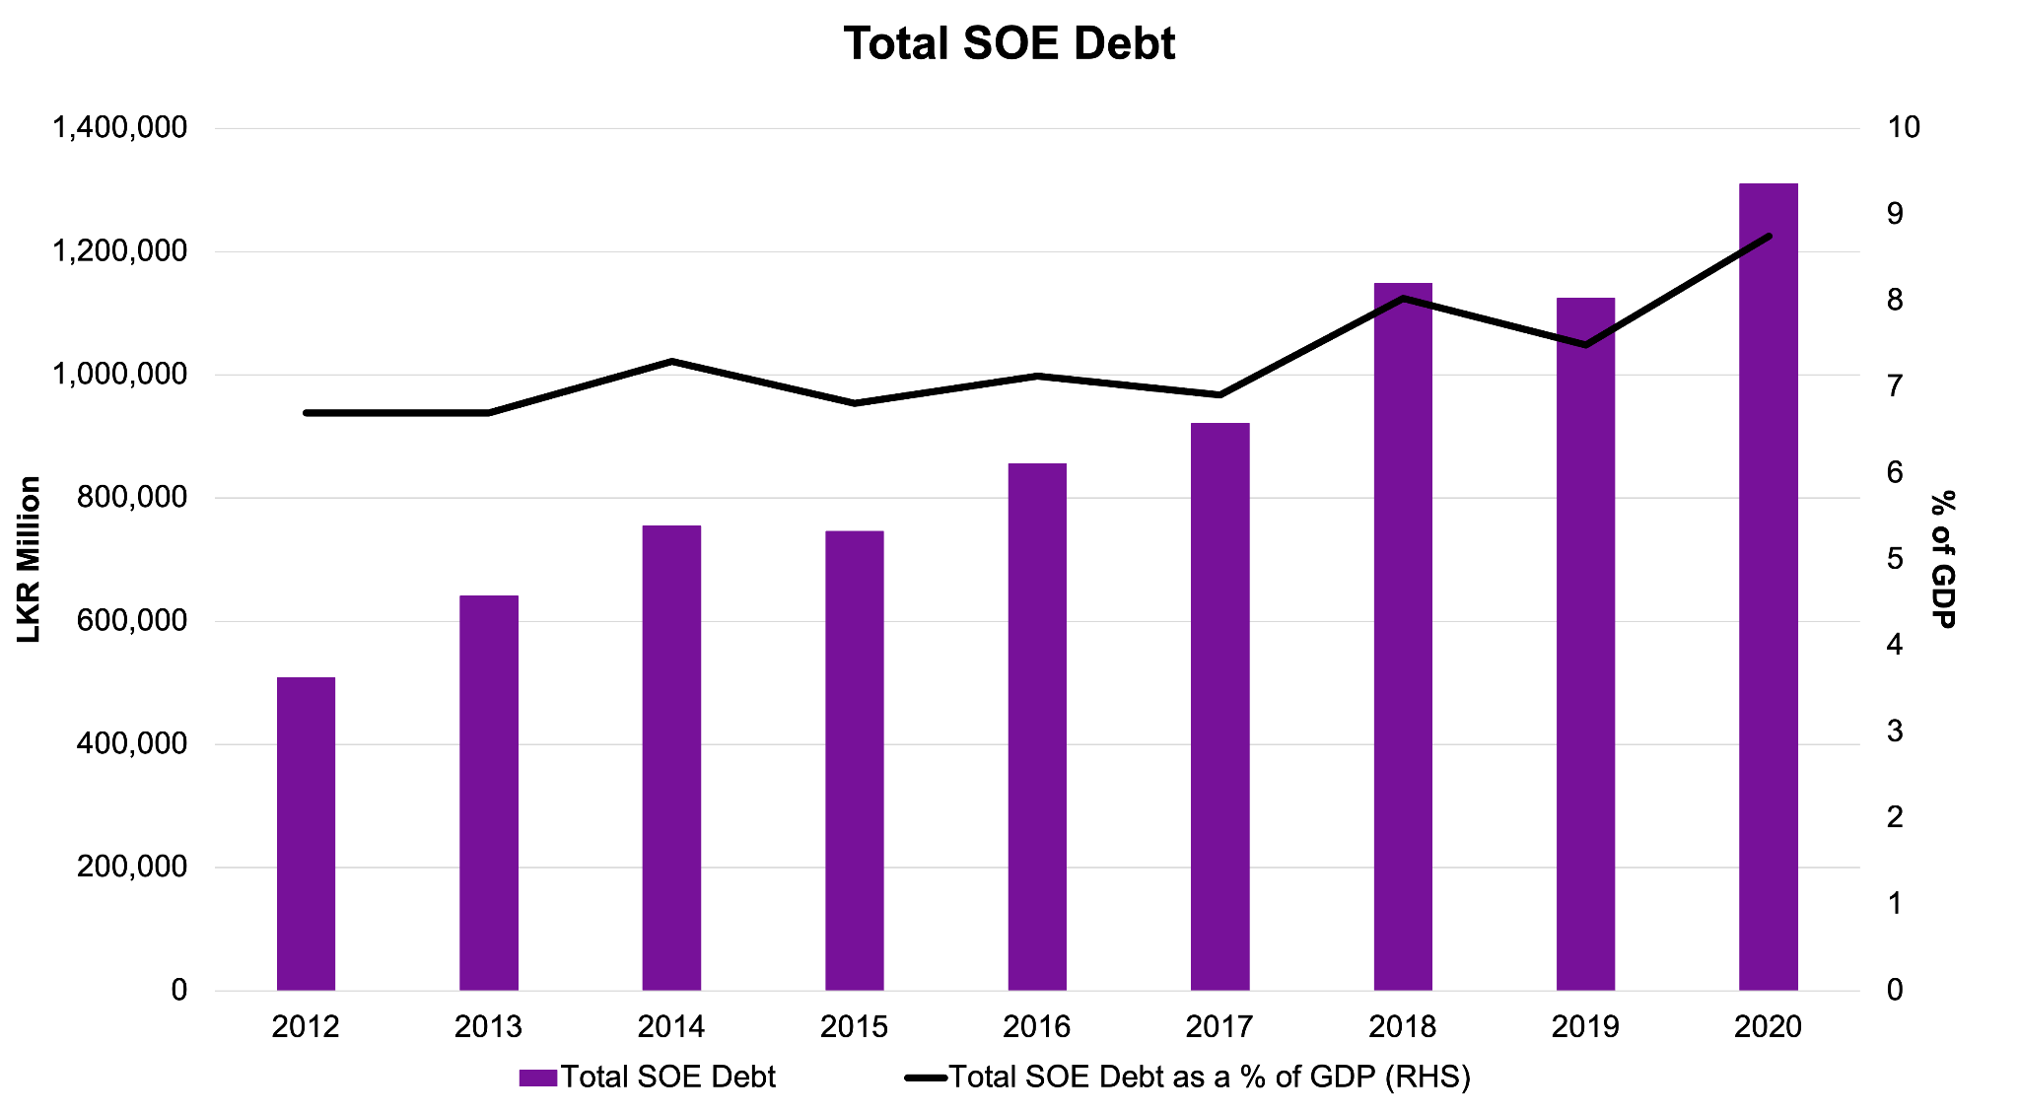
Note: Total SOE debt includes only non financial public corporations
Source: Central Bank of Sri Lanka Annual Reports
& Ministry of Finance Annual Reports

Slide 11
Comparing SOE losses to government welfare expenditure.
Year | SOE Losses as a percentage of Samurdhi | SOE Losses as a Percentage of Health | SOE Losses as a percentage of Education
2015 | 142.06% | 31.96% | 45.43%
2016 | 84.33% | 18.46% | 14.42%
2017 | 203.23% | 41.00% | 31.35%
2018 | 394.92% | 70.93% | 58.06%
2019 | 310.92% | 56.84% | 47.84%
Source: Annual Reports of Ministry of Finance &
Advocata Institute’s Database on Financial Information of SOEs

Slide 12
Financials of the Big 4 SOEs

Slide 15
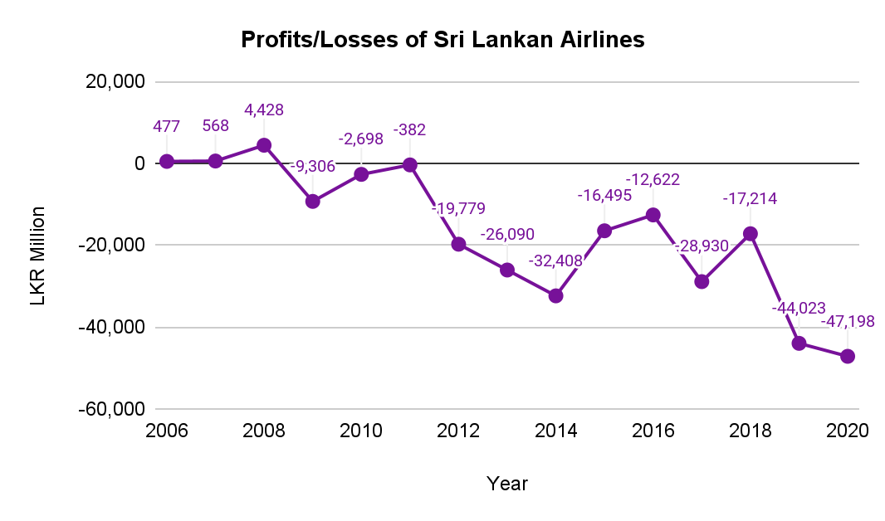
- - - - - - - - - - - - - - - - - -
Managed by
Emirates
Managed by
Government of Sri Lanka
Source: Sri Lanka Airlines Annual Reports

Slide 16
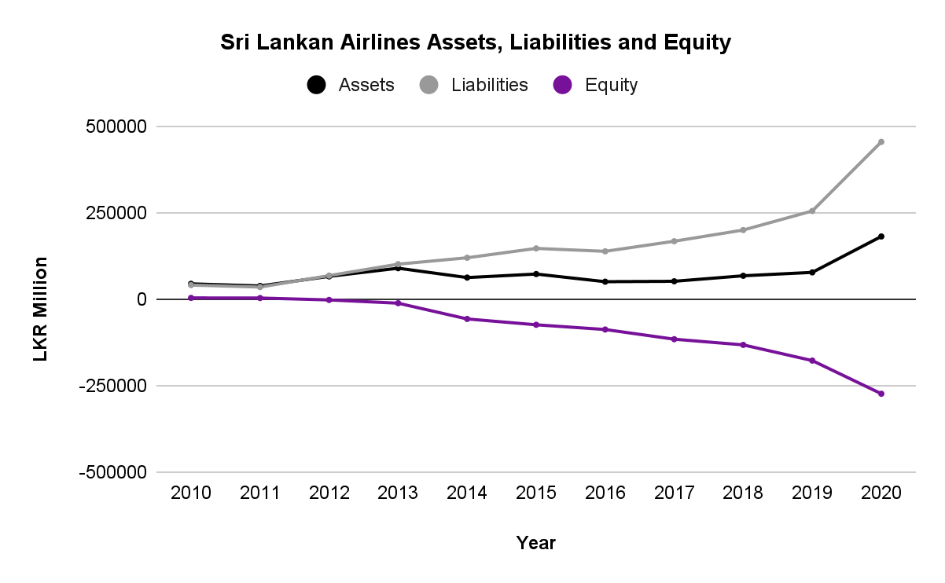
Source: Sri Lankan Airlines Annual Reports

Slide 17
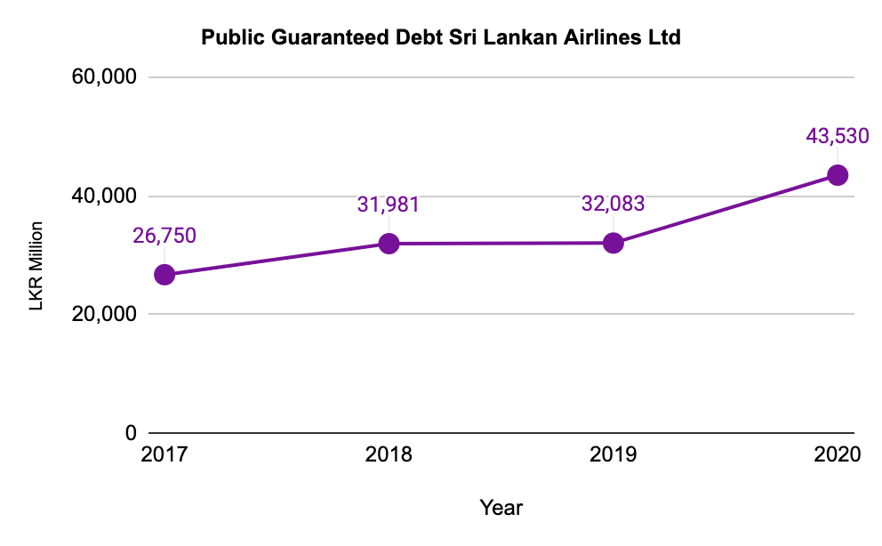
Source: Central Bank of Sri Lanka Annual Report 2020

Slide 18
Ceylon Petroleum Corporation

Slide 19
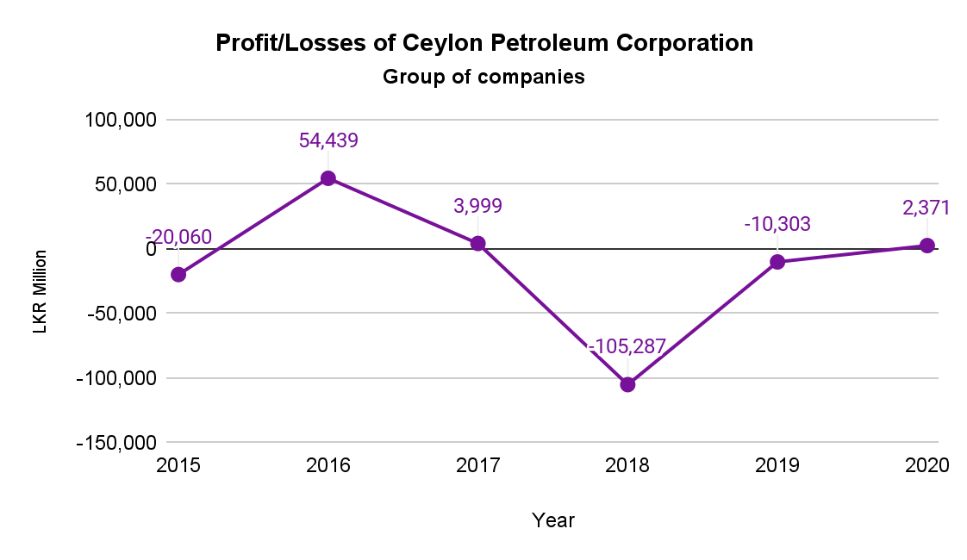
Note: 2020 value is for CPC only
Source: Annual Reports of the Ceylon Petroleum Corporation
& Annual Reports of Ministry of Finance

Slide 20
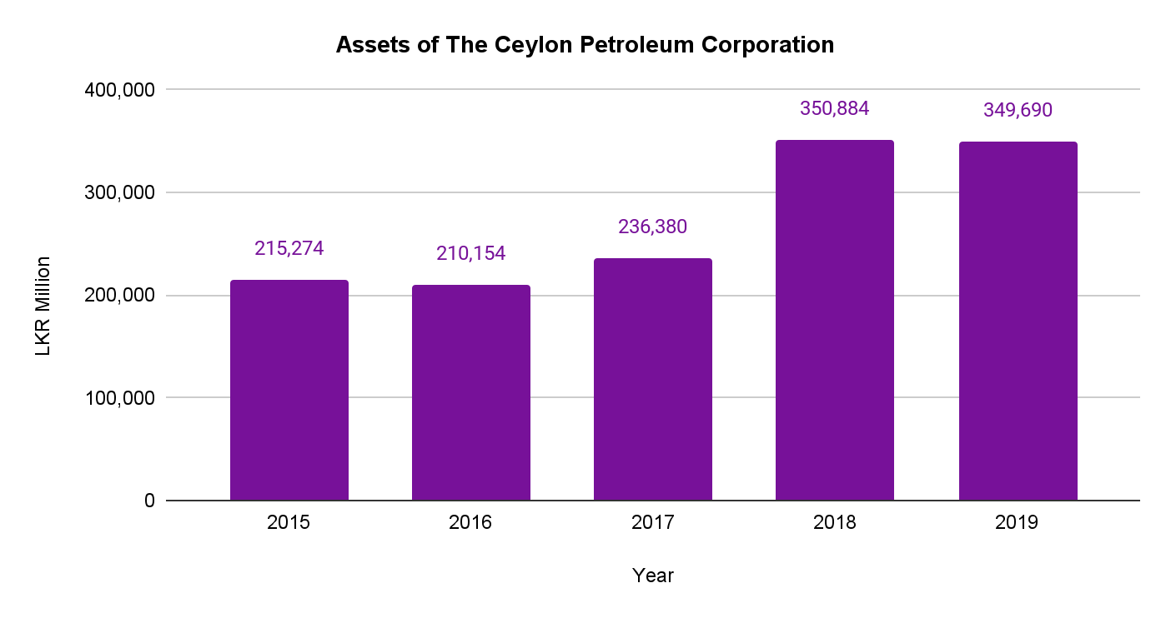
Source: Annual Reports of the Ceylon Petroleum Corporation

Slide 21
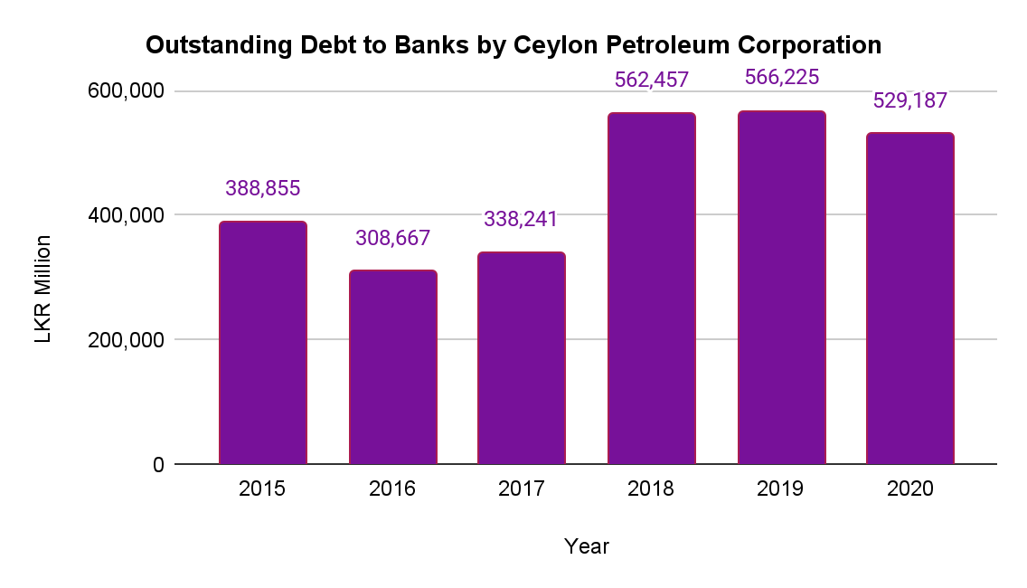
Source: Annual Reports of Ministry of Finance

Slide 23
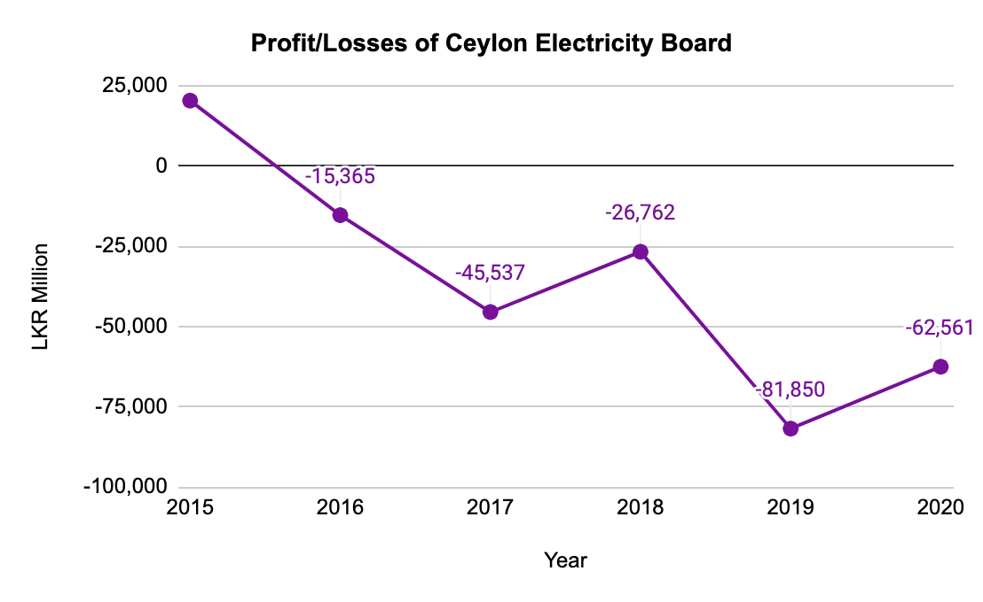
Source:Annual Reports of the Ceylon Electricity Board
& Annual Reports of Ministry of Finance

Slide 24
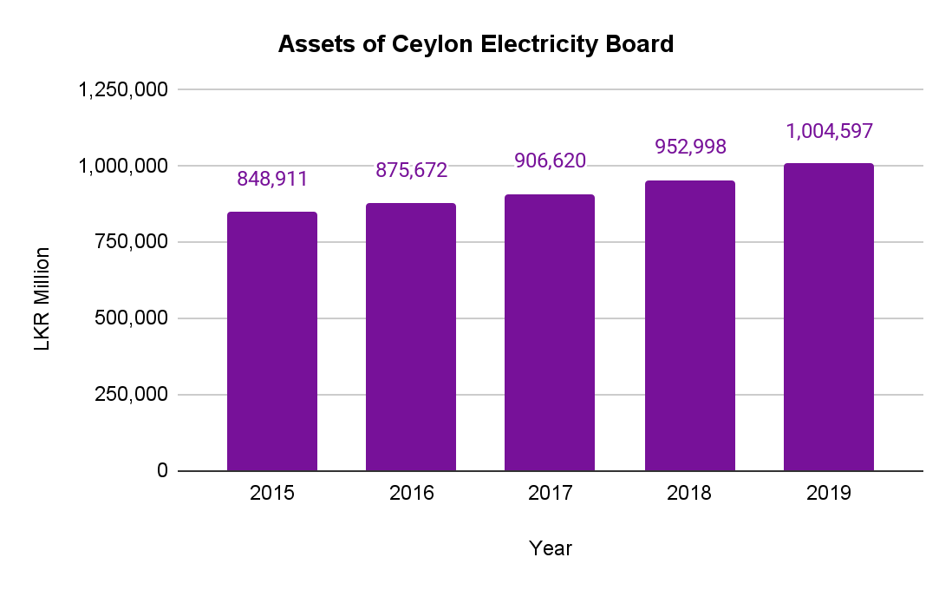
Source: Annual Reports of the Ceylon Electricity Board

Slide 25
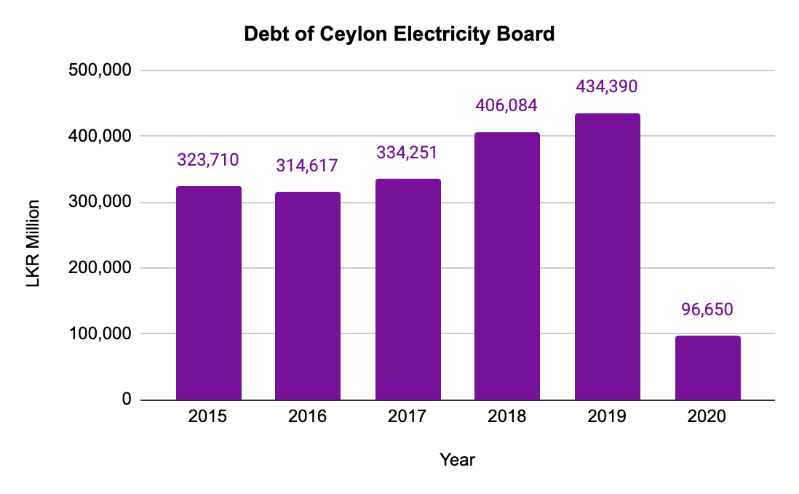
Note: 2020 value is Outstanding Debt to banks only
Source: Annual Reports of the Ceylon Electricity Board &
Annual Reports of Ministry of Finance

Slide 27
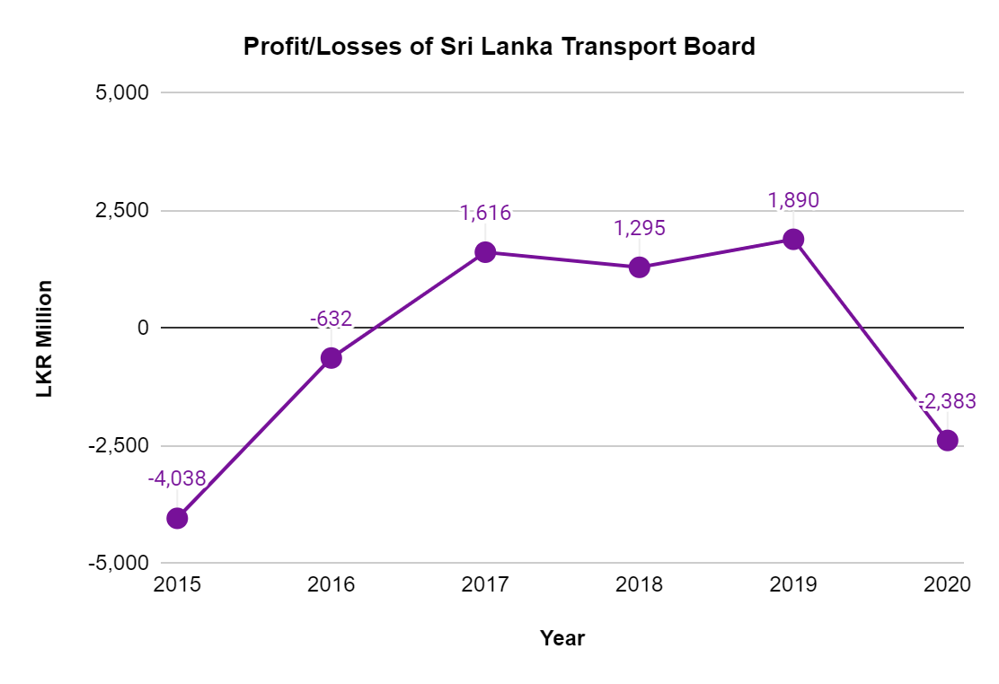
Source: Annual Reports of Public Enterprise Department & Annual reports of the Ministry of Finance

Slide 28
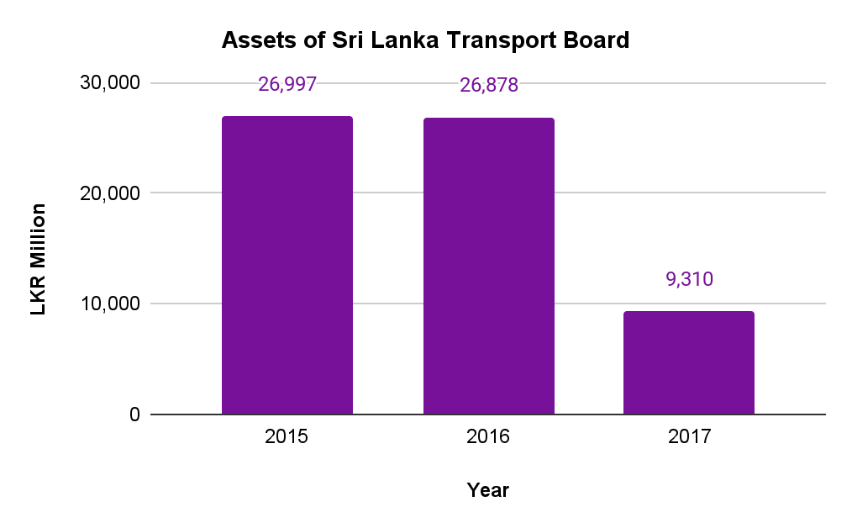
Source: Annual Reports of Public Enterprise Department

Slide 29
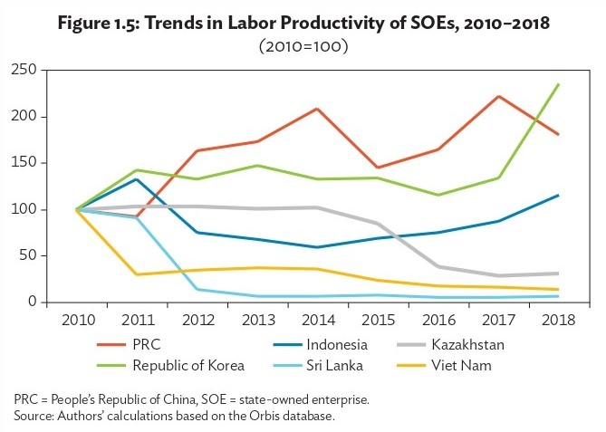
Cross-country Comparison of Labour Productivity of SOEs
Source: Reforms, Opportunities, And Challenges For State-Owned Enterprises, Asian Development Bank

Slide 30
The Big Picture
Structural Inefficiencies
a) The Agency Problem
b) Political costs and agency costs
Patronage
Corruption
The Monopolistic Power of SOE’s / Competitive Neutrality and Anti-Competitive Behavior
Problems Caused by
State Owned Enterprises
Exemptions from Antitrust Policies
Lack of a competitive level playing field
Direct Subsidies
Concessionary Financing
State Backed Guarantees
Preferential Regulatory Treatment
No Bankruptcy Rules
Unsustainable Debt
Market Failure
Burden on the State
Lack of Incentives
a) Improve productivity and efficiency
b) Innovation

Slide 31
The Policy Solution

Slide 32
Present Challenges
Data Financial and Non Financial
1 .Missing data

Slide 33
2. Frequency/availability of SOE Annual Reports.
Unavailability of SOE Annual Reports
 | 2015 | 2016 | 2017 | 2018 | 2019 | 2020
No. | 12 | 18 | 18 | 31 | 21 | 46
as % | 21.82% | 32.73% | 32.73% | 56.36% | 38.18% | 83.64%
PED reports from 2018 onwards have not been published.

Slide 34
3.Right To Information Requests (RTIs):
No. of SOEs to which RTIs were filed. | Replies Received | No Acknowledgement | Replies Received within 14 days
52 | 9 | 43 | 2
 | Information Received
 | 5
 | Acknowledged but no information received
 | 2
 | Rejections
 | 2

Slide 35
Thank You

